Slide 1


Anywhere, Anytime, Anyone
CB Students
Student Email
Lync
Web Apps
Microsoft Office
OneDrive
Notes:
Please explain that Office 365 has many tools. It can be used at home and at school.

Slide 2
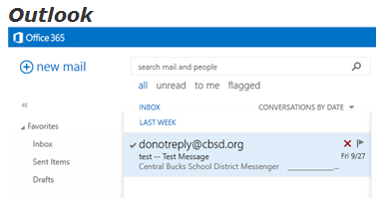
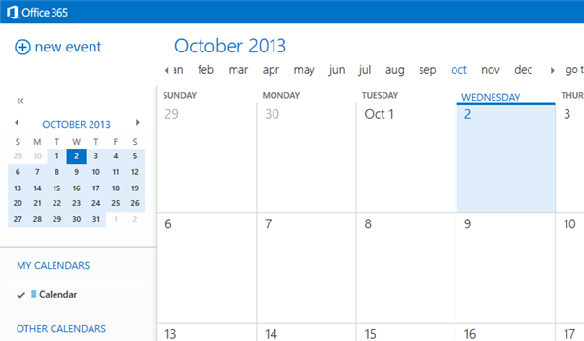

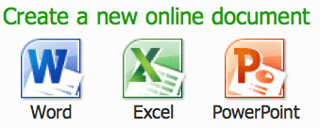
Connect and Collaborate Virtually Anywhere, Anytime
Office 365 Offers:
Student Email
Student Calendar
Web Apps
Cloud Storage
Notes:
Office 365 is available for teachers and students (5-12). Mention the 4 tools that will be offered with 365.

Slide 3

Connect and Collaborate Virtually Anywhere, Anytime
Update: Microsoft Office 365 ProPlus is now available for Central Bucks students in grades 5-12. This gives all students Office 2013 for free.
http://www.cbsd.org/OfficeProPlus
Try this at home!

Slide 4

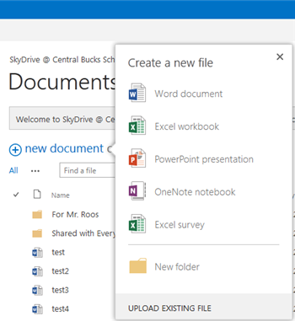
Connect and Collaborate Virtually Anywhere, Anytime
Web Apps
Word, Excel and PowerPoint can all open within a browser
Software is not needed
Teachers can comment on student work in real time
Students can work together online
Notes:
Word, Excel and PowerPoint can all be utilized by individuals or in group collaboration. All documents open within a browser but still have the look and feel of Office. A nice feature is that Office is not needed on the machine because this document will work on most devices that have a web browser.

Slide 5

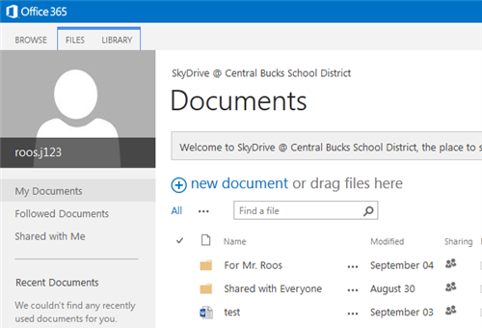
Connect and Collaborate Virtually Anywhere, Anytime
OneDrive
Teachers receive 25 GB of cloud storage
Documents can be accessed whenever you have an Internet connection, from almost any device
Documents can be private or shared
Collaboration on documents is available
Notes:
Please explain that all users are gaining 25 GB of storage space in the cloud. (The I drive only has 4 GB) They can begin using this service today. The log-in for the OneDrive is the same for all Office 365 tools: http://www.cbsd.org/365. Teachers each have 25GB. Storage is not meant for personal files, but rather work/school related content.

Slide 6

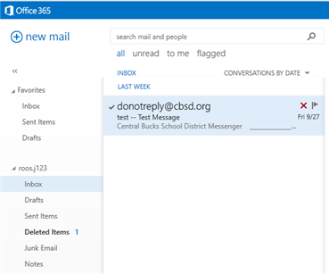
Connect and Collaborate Virtually Anywhere, Anytime
Student Email
A professional, common email address format (@student.cbsd.org)
Easy to share content with classmates and teacher such as:
  Websites
  Articles
  Projects
  Study Guides
Notes:
Remind students that email is monitored, should be appropriate and should be used for educational reasons.

Slide 7
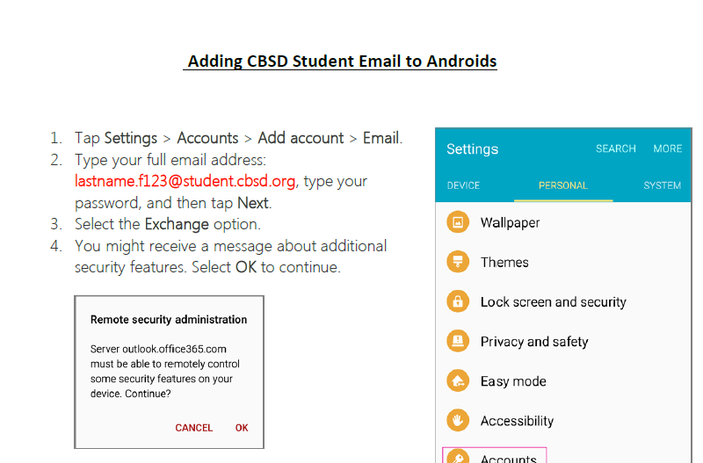
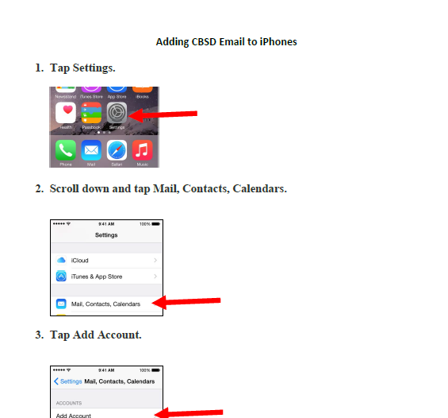
Setting Up Phones

